Slide 1
Data Mining (CS 451)
JAN-MAY’ 18
PRAGYA VERMA

Slide 2
RECAP
Association Rule Mining: Basic Concepts

Slide 3
CONTENT
Frequent Itemset Mining Methods
Apriori Algorithm: Finding Frequent Itemsets by Confined Candidate Generation
Generating Association Rules from Frequent Itemsets
Practice Question

Slide 4
Apriori Algorithm
Apriori is a seminal algorithm used for mining frequent itemsets for Boolean association rules
The name of the algorithm is based on the fact that the algorithm uses prior knowledge of frequent itemset properties.
Apriori employs an iterative approach known as level-wise search, where k-itemsets are used to explore (k+1)-itemsets.

Slide 5
Apriori Algorithm (Contd.)
First the set of frequent 1-itemsets is found by scanning the database to accumulate the count for each item, and collecting those items that satisfy the minimum support.
The resulting set is denoted by L₁. Next, L₁ is used to find L₂, the set of frequent 2-itemsets, which is used to find L₃ and so on, until no more frequent k-itemsets can be found.
The finding of each L_{k} requires one full scan of the database.
To improve the efficiency of the level-wise generation of frequent itemsets, Apriori Property is used.
According to the Apriori Property, all nonempty subsets of a frequent itemset must also be frequent.

Slide 6
Apriori Algorithm (Contd.)
Steps in Apriori Algorithm:
In the first iteration of the algorithm, each item is a member of the set of candidate 1-itemsets, C₁. The algorithm simply scans all the transactions to count the number of occurrences of each item.
The set of frequent 1-itemsets, L₁, is then determined. It consists of the candidate 1-itemsets satisfying minimum support.
To discover the set of frequent 2-itemsets, L₂, the algorithm uses the join L₁⋈ L₁ to generate a candidate set of 2-itemsets, C₂.

Slide 7
Apriori Algorithm (Contd.)
Next, the transaction in D are scanned and the support count of each candidate itemset in C₂ is accumulated.
The set of frequent 2-itemsets, L₂ is determined, consisting of those candidate 2-itemsets in C₂ having minimum support.
Next, C₃ is generated from L₂ ⋈ L₂.
The transactions in D are scanned to determine L₃, consisting of those candidate 3-itemsets in C₃ having minimum support.
The algorithm terminates, having found all the frequent itemsets.

Slide 8
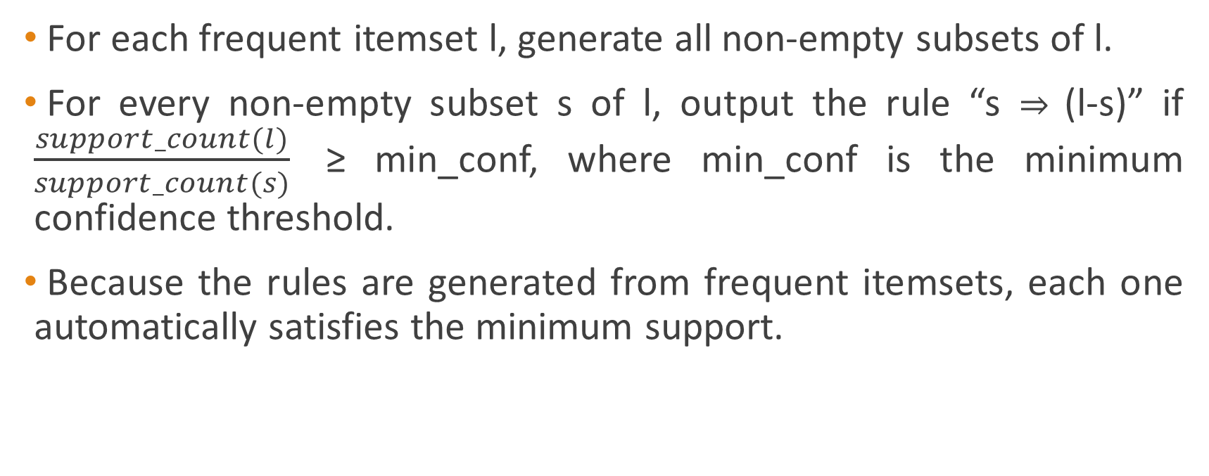
Generating Association Rules from Frequent Itemsets
For each frequent itemset l, generate all non-empty subsets of l.
For every non-empty subset s of l, output the rule “s ⇒ (l-s)” if $\frac{support_count(l)}{support_count(s)}$ ≥ min_conf, where min_conf is the minimum confidence threshold.
Because the rules are generated from frequent itemsets, each one automatically satisfies the minimum support.

Slide 9
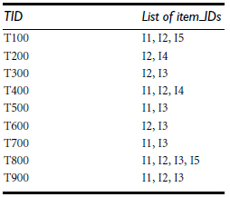
Practice Question
Using Apriori Algorithm, find frequent itemsets in the following database:

Slide 10
Next Class
Improving the Efficiency of Apriori Algorithm

